Slide 1

Understanding IPL 2020 Through Data Analysis
A Simple Guide to Teams, Players, and Predictions
Created by [Rishi Vishal Garlapati & Co] with Python tools

Slide 2
What’s This All About?
We used data (like numbers and comments) to understand IPL 2020.
Here’s what we’ll cover:
1. Team points: Who scored the most?
2. Fan feelings: What did people say on Twitter and YouTube?
3. Top players: Who hit the most runs or played the fastest?
4. Experts’ thoughts: What did the pros think about teams?
5. Prediction: Can we guess the winner?

Slide 3
Our Toolkit
We wrote a program using Python (a computer language) to analyze data.
Key helpers:
- Pandas: Organizes data like a spreadsheet.
- Matplotlib & Seaborn: Makes colorful charts.
- TextBlob: Checks if comments are happy or sad.
- Sklearn: Helps predict the winner.
Think of it like using a calculator and crayons for cricket data!

Slide 4

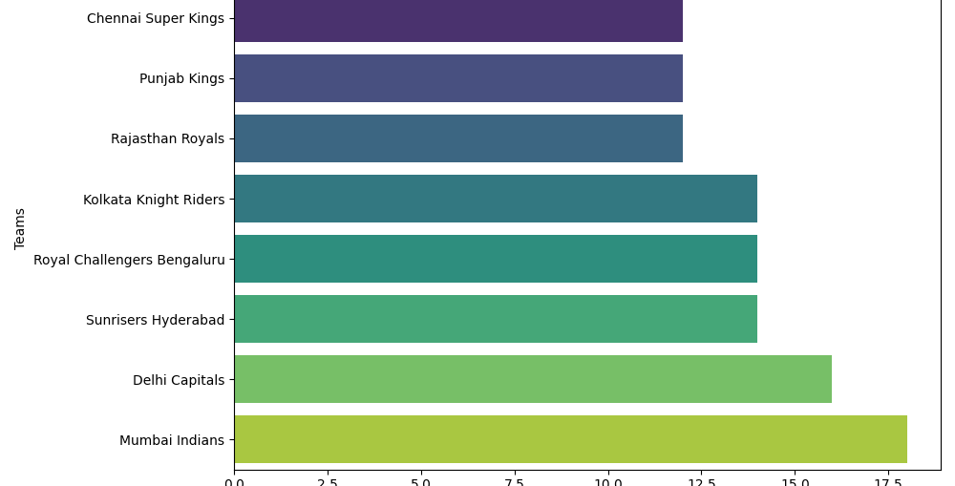
Who’s Winning? The Points Table
We loaded a file called 'ipl2020_points_table_summary.csv' with team names and their points.
Made a bar chart showing points for each team (higher bars = more points).
Example: If Mumbai Indians have the tallest bar, they’re leading!
This chart tells us which teams did well in IPL 2020 based on points.

Slide 5
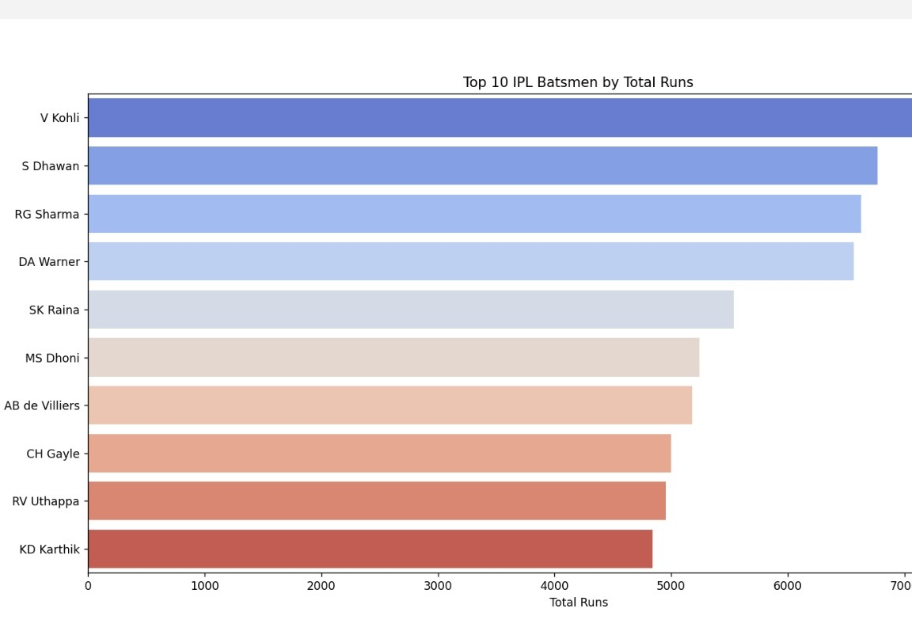
Run Machines: Top 10 Scorers
We used 'ndtv_sports_cleaned_data_stats.csv' to find players with the most runs.
Picked the top 10 and made a bar chart.
Example: If Virat Kohli has a long bar, he scored a lot!
This shows who were the biggest run-scorers in IPL 2020.

Slide 6
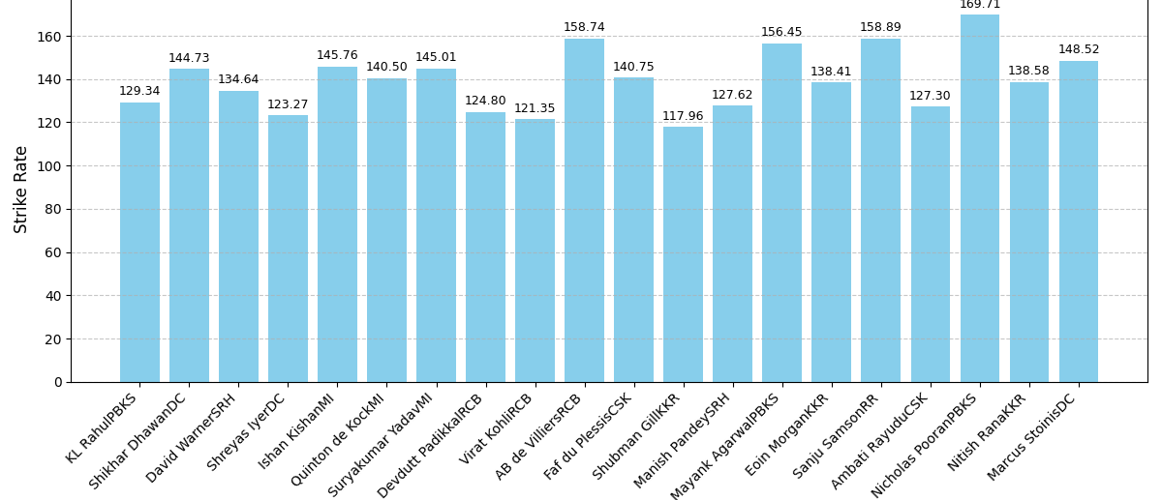
Fast Hitters: Top 10 Strike Rates
Strike Rate = How fast a player scores runs.
From the same player stats file, we picked the top 10 fastest hitters.
Made another bar chart to show this.
Longer bars mean the player hits runs quickly—like a sprint!

Slide 7
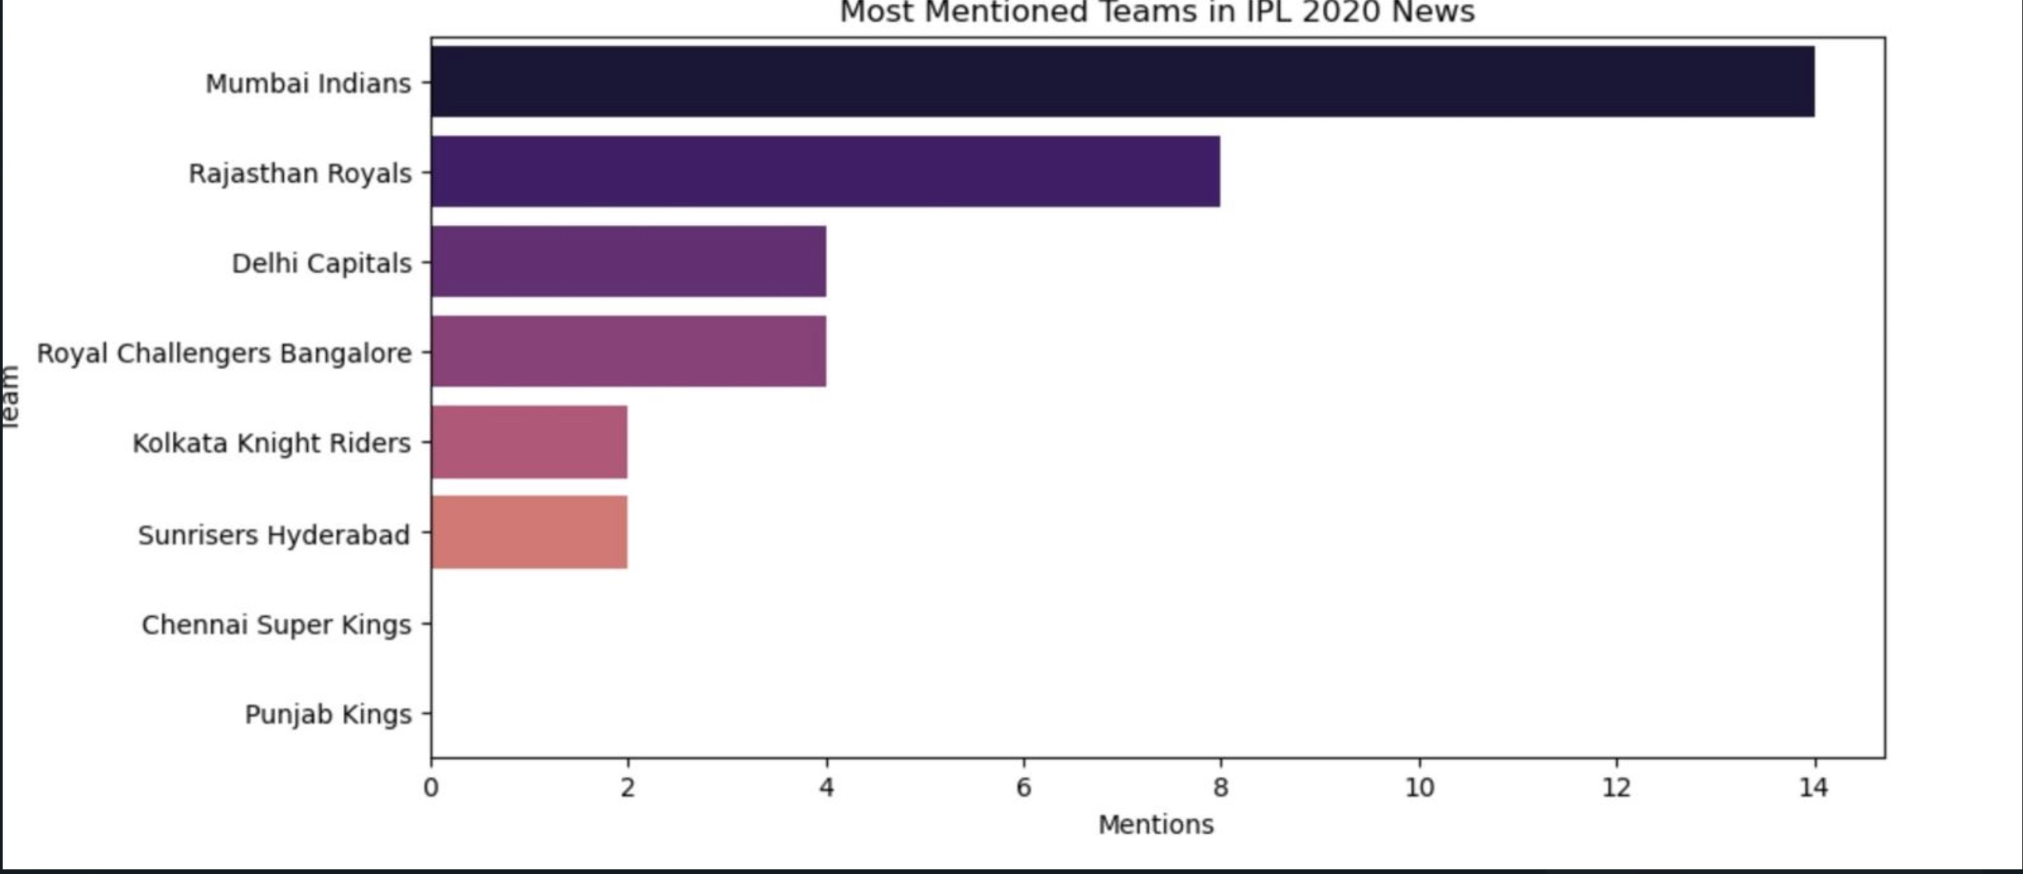
Google Trends data was used to analyze the search interest around IPL 2020.
This provides insights into public interest and engagement with teams, players, and key match dates.
Mumbai Indians had the highest number of mentions, indicating strong media and public attention.
Rajasthan Royals, Delhi Capitals, and RCB followed, showing their relevance in the season.

Slide 8
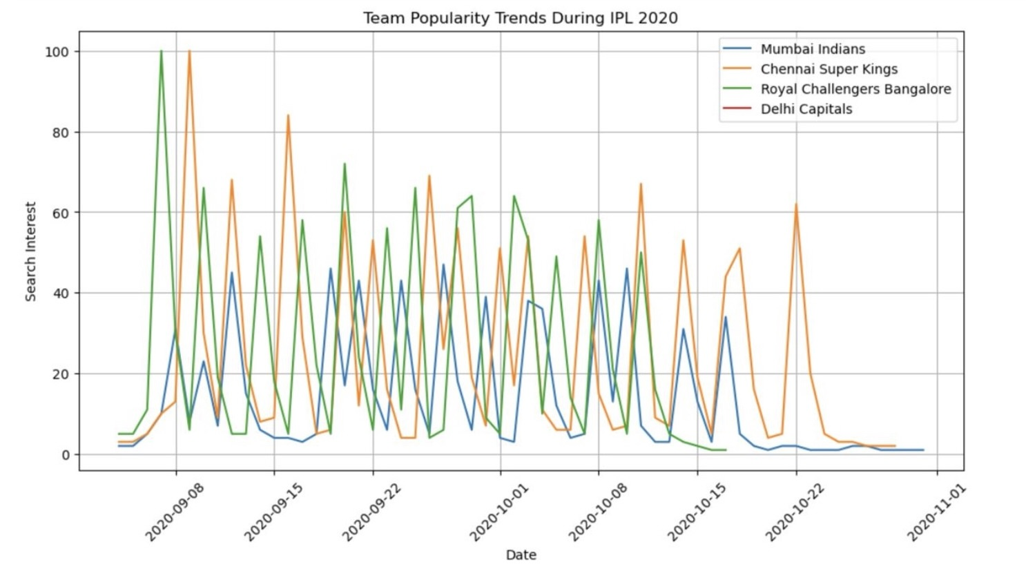
Compares search interest for popular teams over the duration of the IPL.
MI and CSK appear to dominate the searches, reflecting strong fan bases.

Slide 9
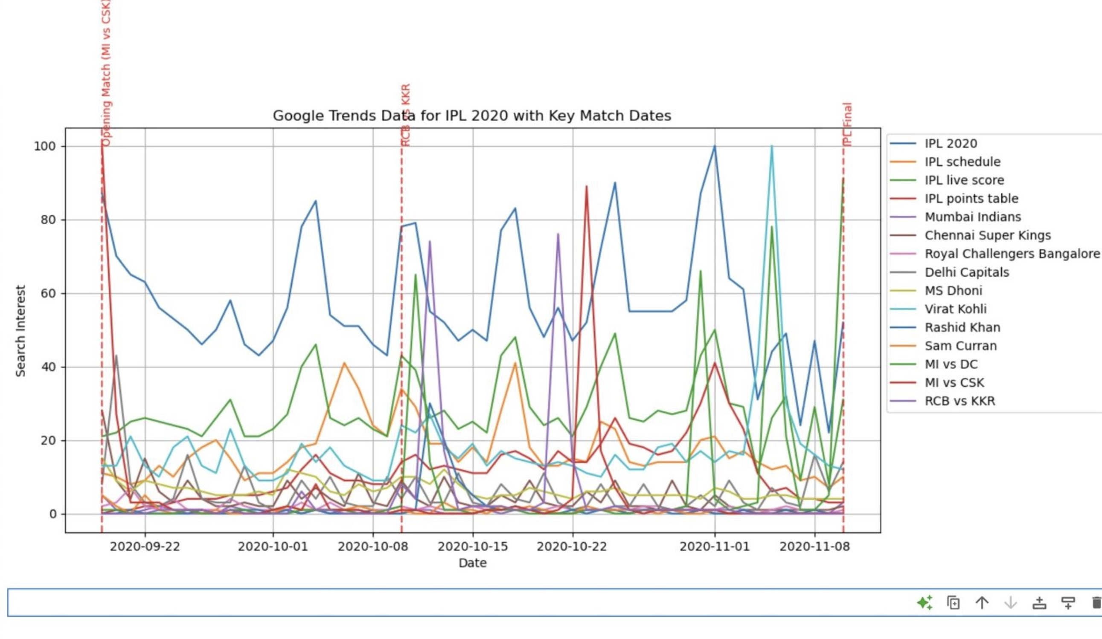
The chart displays spikes in search interest around key match dates.

Slide 10
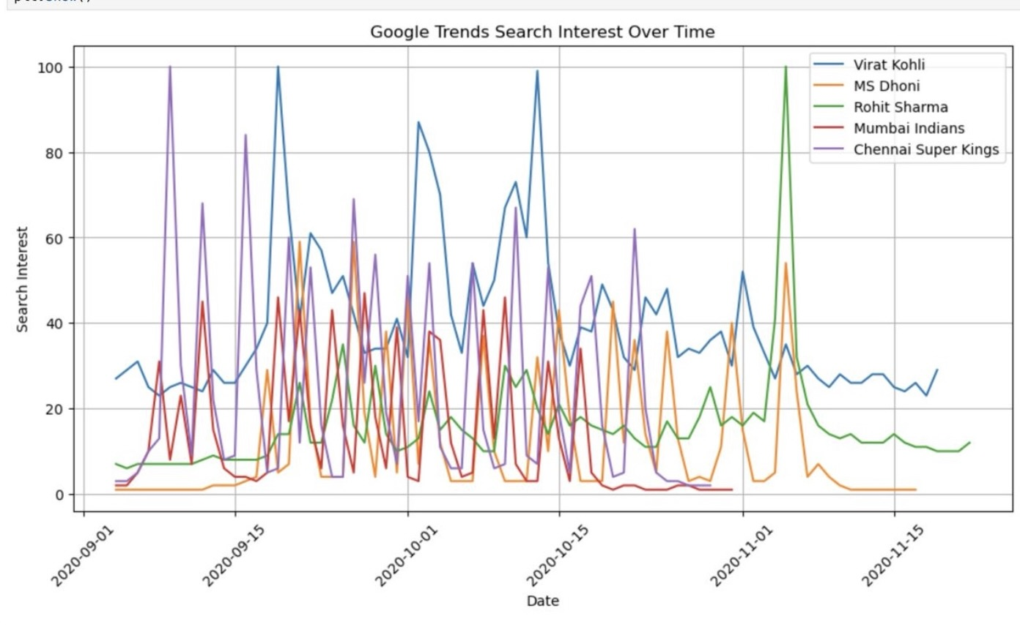
Players
Individual Players such as Virat Kohli, MS Dhoni, and Rohit Sharma had high search interest.

Slide 11
Relevance:
Bridging Public Interest and Performance
Identifying Most Discussed Teams and Players
Impact of Match Results on Online Discussions
Sentiment Analysis and Predictive Insights
Understanding Fan and Market Trends

Slide 12
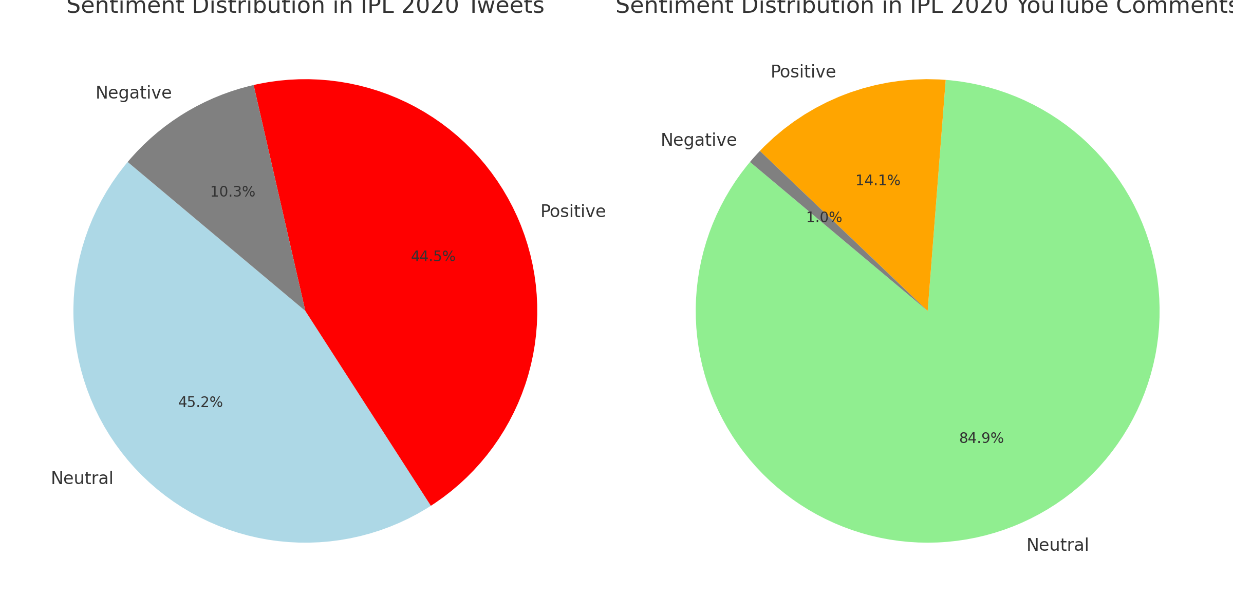
What Did Fans Say?
Trend Over Time: The "Sentiment Trend Over Time" chart shows spikes in tweet counts, especially in October, likely during key IPL matches. Positive sentiments often outnumbered negative ones, suggesting overall fan enthusiasm.
Match Impact: The "Sentiment Trends vs. Match Results" chart indicates that positive sentiment spikes after wins (e.g., MI’s victory in the final on November 10), while negative sentiment rises during losses or controversies.
Finalists’ Sentiment: MI had more positive sentiment than DC, especially around the final, reflecting fan support for the winning team.

Slide 13
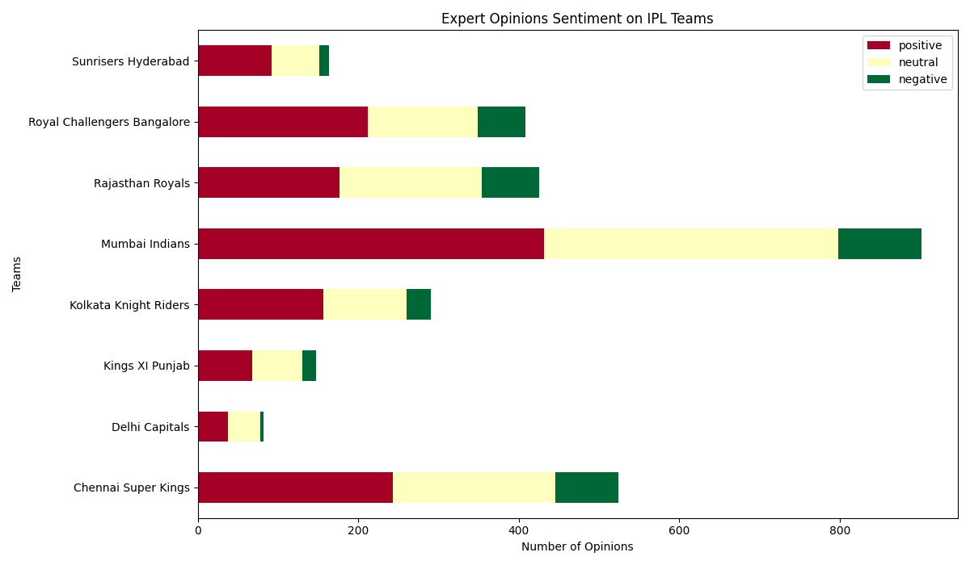
What Did the Experts Think?
TextBlob: For calculating sentiment polarity of tweets and comments. It’s easy to use and provides a polarity score that I categorized into Positive, Negative, or Neutral.
Pandas: For data manipulation, such as loading CSVs, grouping data by date, filtering tweets for specific teams, and handling datetime conversions.
Matplotlib and Seaborn: For creating visualizations (line plots for trends, histograms for distributions).
Python: As the programming language to tie everything together.

Slide 14
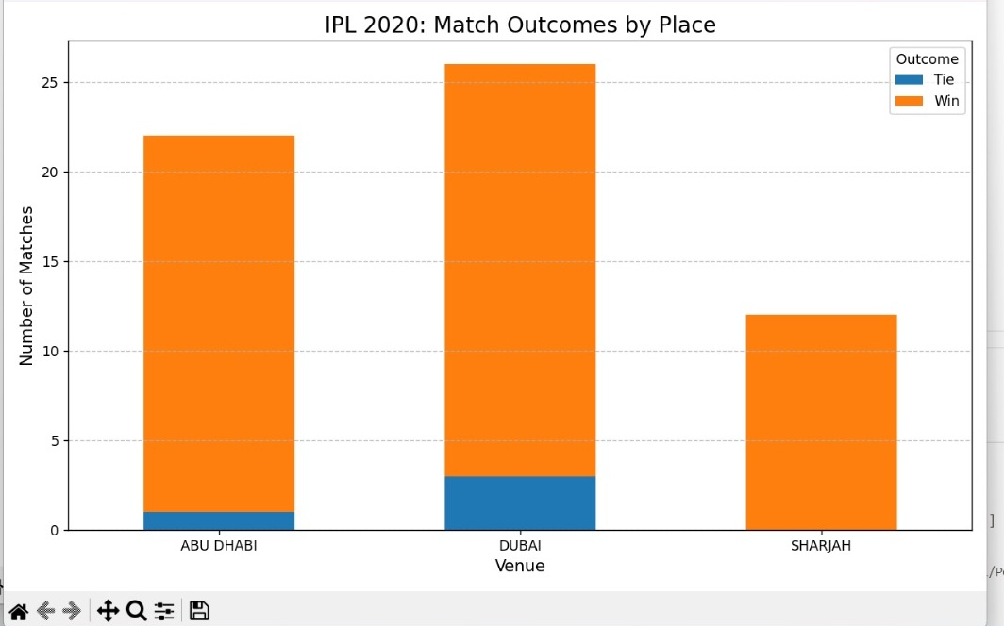
Wins by place
Description: This bar chart shows how matches played at different venues in IPL 2020 ended – either as a win (orange) or a tie (blue).
Key Insights:
Dubai hosted the highest number of matches.
Abu Dhabi followed closely with slightly fewer games.
Sharjah had the least number of matches.
Tied matches were rare across all locations.
Conclusion: This visualization helps analyze the influence of venues on match outcomes.

Slide 15
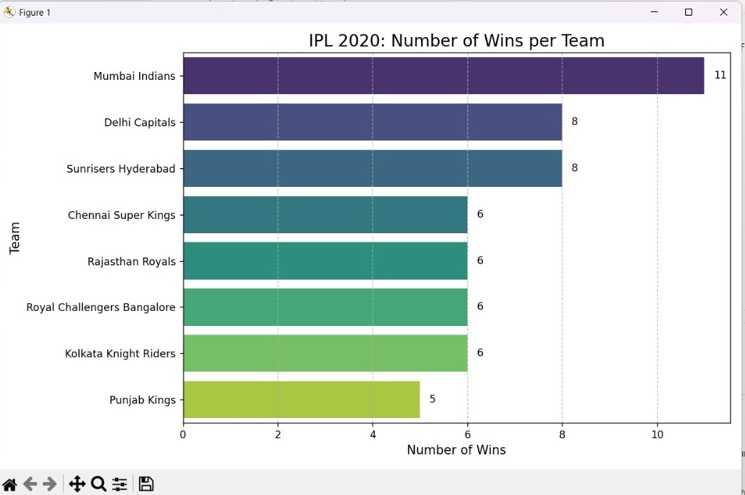
Wins per team
Description: A horizontal bar chart showing the total number of matches won by each team in IPL 2020.
Key Insights:
Mumbai Indians (MI) won the most matches (11 wins).
Delhi Capitals (DC) and Sunrisers Hyderabad (SRH) were the second-best teams with 8 wins each.
Other teams like Chennai Super Kings (CSK), Rajasthan Royals (RR), and RCB had moderate performances with 6 wins each.
Punjab Kings (PBKS) had the lowest win count (5 wins).
Conclusion: Mumbai Indians were the most dominant team in IPL 2020.

Slide 16
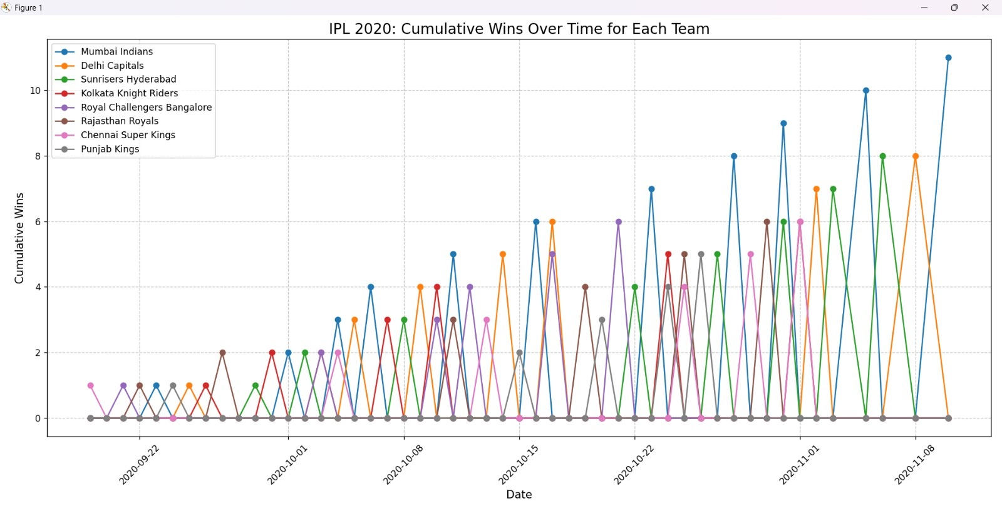
Wins over time
Description: A line chart that shows the cumulative wins of each IPL team throughout the tournament.
Key Insights:
The Mumbai Indians’ (MI) line is the highest, showing their consistent success over the season.
Delhi Capitals (DC) and Sunrisers Hyderabad (SRH) kept pace but couldn’t match MI’s dominance.
Teams like Chennai Super Kings (CSK) and Punjab Kings (PBKS) had fluctuating performances.
The peaks in the graph correspond to match days when teams secured victories.
Conclusion: This visualization helps track a team’s progress in IPL 2020 and how they performed over time.

Slide 17
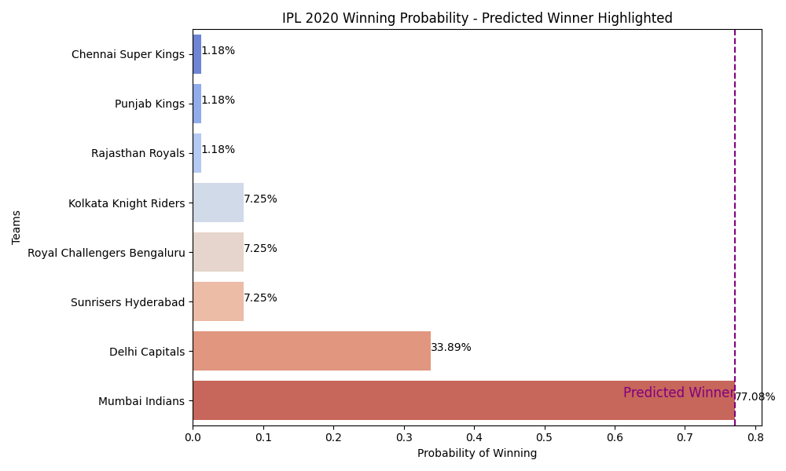
Who Wins IPL 2020?
We used a math trick called Logistic Regression to guess the winner.
Trained it with team points: The team with the most points is the ‘winner’ (1), others are 0.
Calculated a 'Winning Probability' for each team and made a chart.
Highlighted the team with the highest chance (purple line).
The team with the longest bar and purple line is our predicted champ!

Slide 18
What We Found
Model Accuracy: 100.00% This means our guess is pretty good!
Predicted Winner: Mumbai Indians.
Why? It had the highest points and probability in our data.
Our program says this team won IPL 2020—let’s see if it’s right!

Slide 19
Wrapping Up
We explored IPL 2020 with data and charts!
Saw team points, fan vibes, top players, expert views, and predicted a winner.
Data can tell fun stories—cricket is more than just a game!
Questions? Let’s chat!

